Slide 1
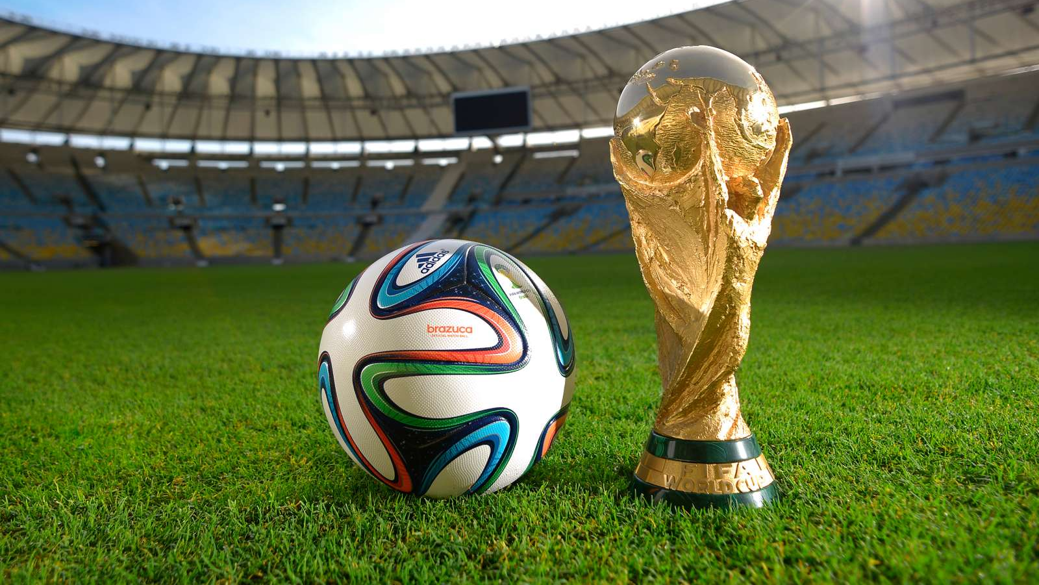
FIFA World Cup Dashboard
By John Ng, Jayne Horton and Andrea Sciubba

Slide 2

Background on FIFA World Cup
Who is FIFA?
211 National associations
6 regional confederations
Tournament held every 4 years
Host country automatically qualifies and qualifying teams split into groups to play round robin matches

Slide 3

Our Story
FIFA has employed team JJA to create a dashboard for officials, teams and soccer fans around the world to investigate trends of successful teams to help with game strategies, future development of the sport and provide general knowledge.

Slide 4

Investigated factors
Distance that the teams have to travel to compete in the World Cup
Frequency of countries that hosted the tournament and the chances of them finishing in the top 4.
The FIFA ranking of the team before they enter the World Cup tournament and where they finished in the tournament
Average number of goals kicked and conceded in matches to compare the impact of the attacking and defending strength of a team
The nationality of the coach and the number of successes achieved with their teams

Slide 5
Designing our Dashboard
ETL process and Data exploration
5 csv files joined to form one database based on the primary key of year and match ID
Rankings obtained from the FIFA website
PostgreSQL Database
Create individual views for each chart created
Used tools such as flask, leaflet, d3, plotly

Slide 6
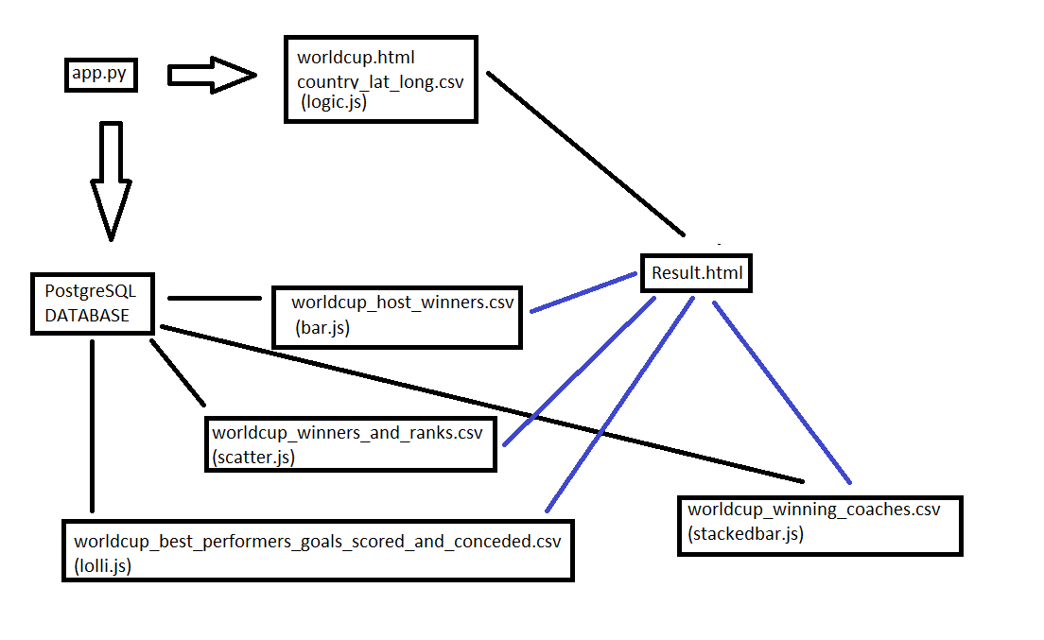

Slide 7
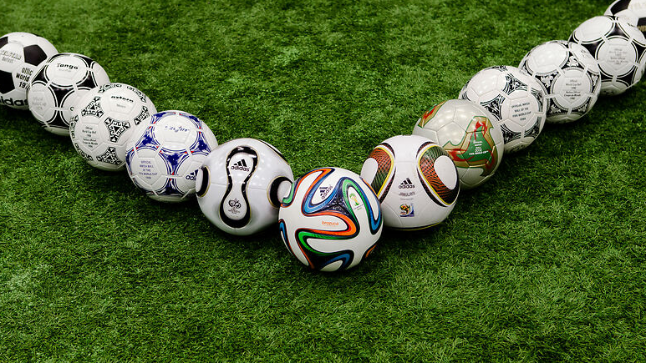
Demo

Slide 8

Prediction for 2018
Using the charts and predicted trends, how did they compare with the actual results for 2018?

Slide 9

Further research
Experience/rotation of players in team
Player profile statistics
Affects of corruption, gambling, salary and match fixing

Slide 10
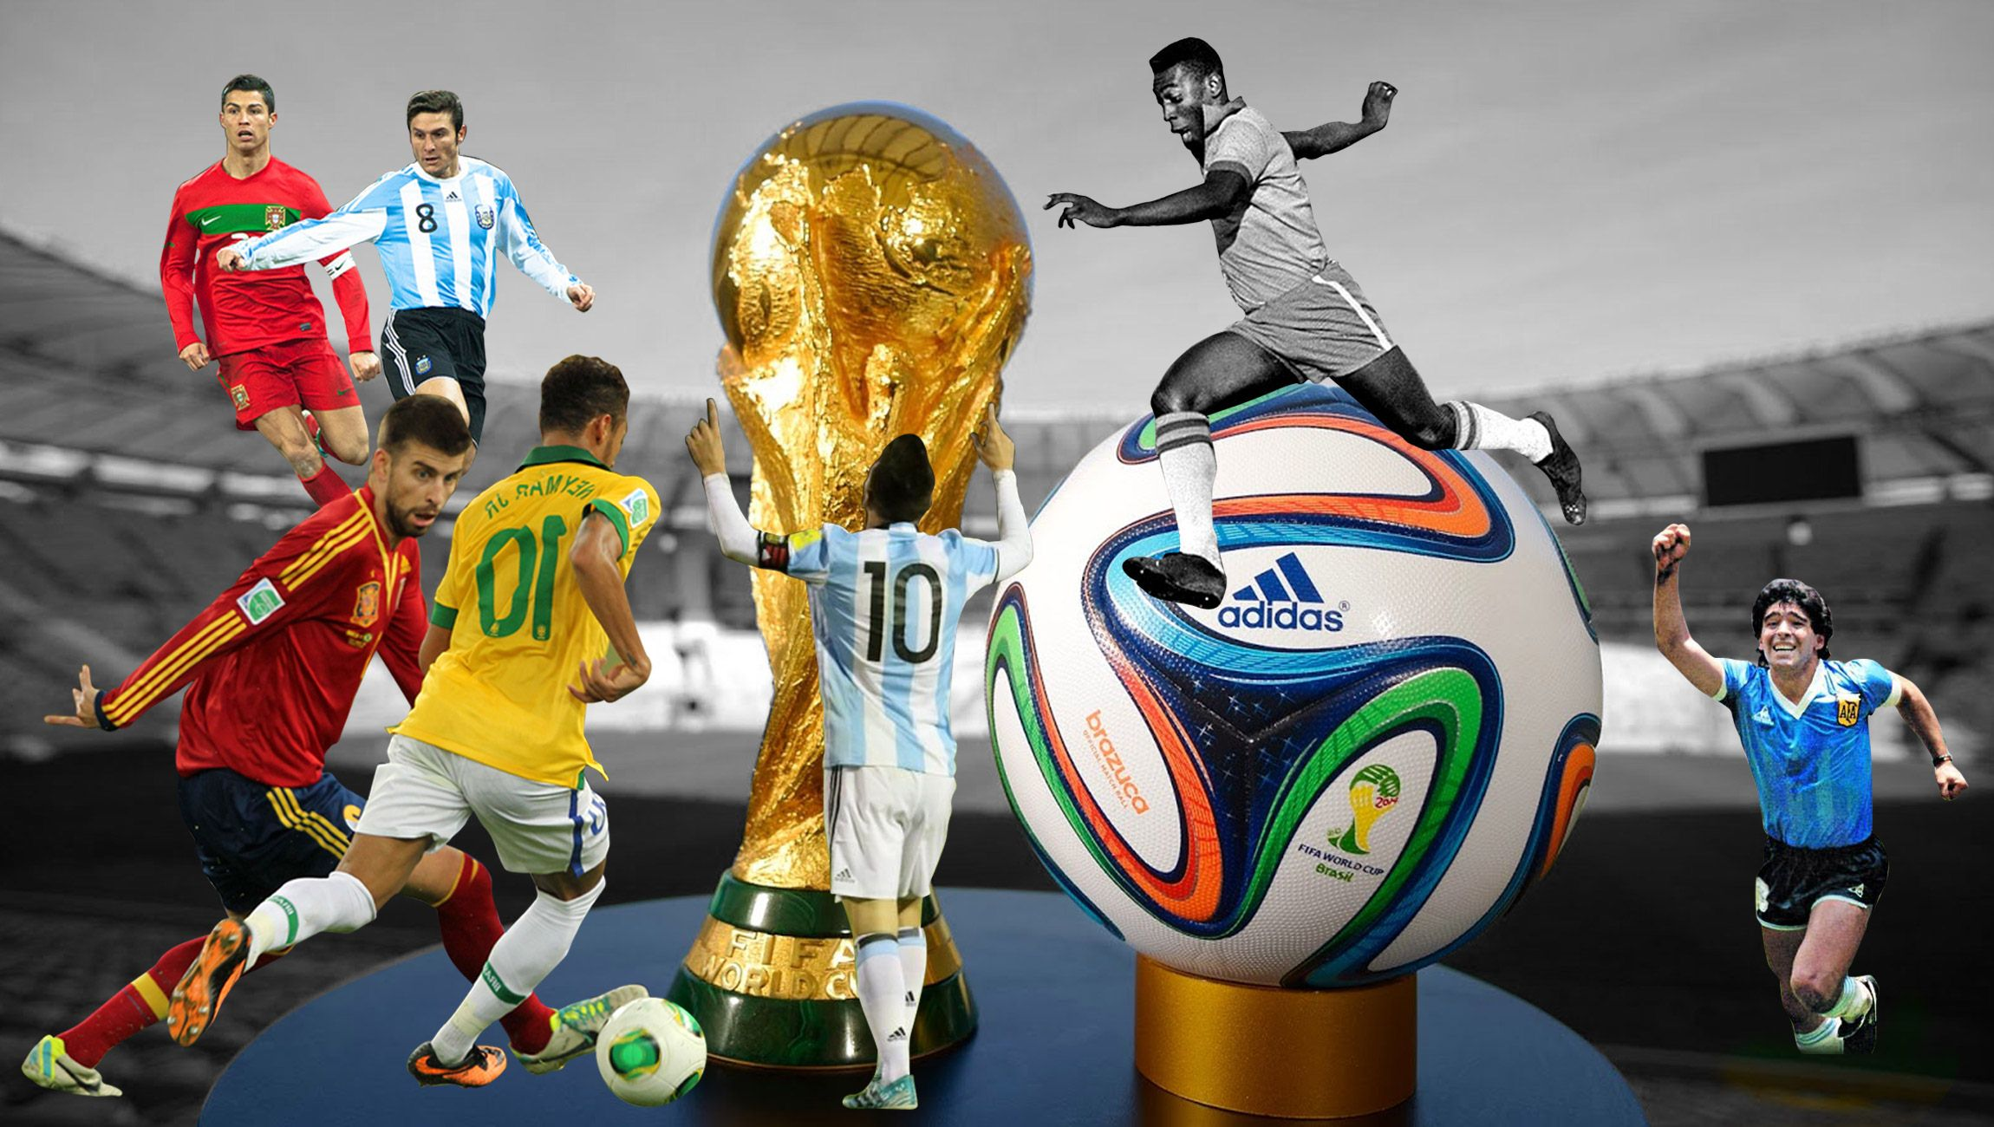
Questions

